Slide 1
Container 생성/접근/삭제

Slide 2
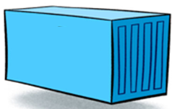
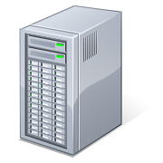


실습 1. Apache Web Server Container 생성과 실행
APS1:80
container
192.168.10.10/24
http://192.168.10.10:8080
http://192.168.10.10:8081
http://192.168.10.10:8082
APS2:80
container
APS3:80
container
Container name | APS1 | APS2 | APS3
Image name | httpd | httpd | httpd
Port No. | 8081:80 | 8082:80 | 8083:80

Slide 3
❶ docker run --name APS1 –d –p 8081:80 httpd
❷ docker images
docker ps
❸ docker run --name APS2 –d –p 8082:80 httpd
docker run --name APS3 –d –p 8083:80 httpd
❹ docker images
docker ps
docker ps -a

Slide 4
❺ docker exec –it APSX /bin/bash
cd /usr/local/apache2/htdocs
cat index.html
echo "<h1>Apache Server NO. X </h1>” > usr/local/apache2/htdocs/index.html
❻ http://192.168.10.10:8081
http://192.168.10.10:8082
http://192.168.10.10:8083

Slide 5
실습 2. Nginx Web Server Container 생성과 실행
APS1:80
container
http://192.168.10.10:8084
APS2:80
container
APS3:80
container
Container name | NGX
Image name | nginx
Port No. | 8084:80
NGX:80
container

Slide 6
❶ docker run --name NGX –d –p 8084:80 nginx
❷ docker images
docker ps
❸ docker exec –it NXS /bin/bash
echo "<h1>Nginx Web Server </h1>" > /usr/share/nginx/html/index.html
❹ http://192.168.10.10:8084

Slide 7
실습 3. MySQL Container 생성과 실행
APS1:80
container
Container name | MySQL
Image name | mysql
MySQL root Password | 1234567
APS2:80
container
MySQL
container
APS3:80
container
NGX:80
container

Slide 8
❶ docker run --name MySQL –dit –e MYSQL_ROOT_PASSWORD=1234567 mysql
❷ docker images
docker ps
❸ docker exec –it MySQL /bin/bash
mysql –u root –p
show databases;
exit

Slide 9
실습 4. Container & Image 삭제하기
WS01:80
container
http://192.168.10.10:8080
http://192.168.10.10:8081
http://192.168.10.10:8082
WS02:80
container
192.168.10.10:8080 | WS01:80
192.168.10.10:8081 | WS02:80
192.168.10.10:8082 | WS03:80
WS03:80
container

Slide 10
❶ docker stop containername
❷ docker ps
docker ps –a
❸ docker rm containername
❹ docker images
docker rmi imagename

Slide 11
WordPress Site 구축
<< Wordpress를 사용한 블로그 서버 구축 >>

Slide 12
Container name | wdserver | mysqlserver
Image name | wordpress | mysql
Network name | wpnet
wpnet
WdPress
container
MySQL
container

Slide 13
❶ Network 생성
docker network create wpnet
❷ MySQL Container 생성
docker run --name mysqlserver -dit --net=wpnet
-e MYSQL_ROOT_PASSWORD=1234567
-e MYSQL_DATABASE=wordpressdb
-e MYSQL_USER=test
-e MYSQL_PASSWORD=1234 mysql
--character-set-server=utf8mb4
--collation-server=utf8mb4_unicode_ci
--default-authentication-plugin=mysql_native_password

Slide 14
❸ WordPress Container 생성
docker run --name wdserver –dit --net=wpnet -p 8085:80
–e WORDPRESS_DB_HOST=mysqlserver
–e WORDPRESS_DB_NAME=wordpressdb
–e WORDPRESS_DB_USER=test
-e WORDPRESS_DB_PASSWORD=1234 wordpress
❹ docker ps
❺ http://192.168.10.10:8085

Slide 15
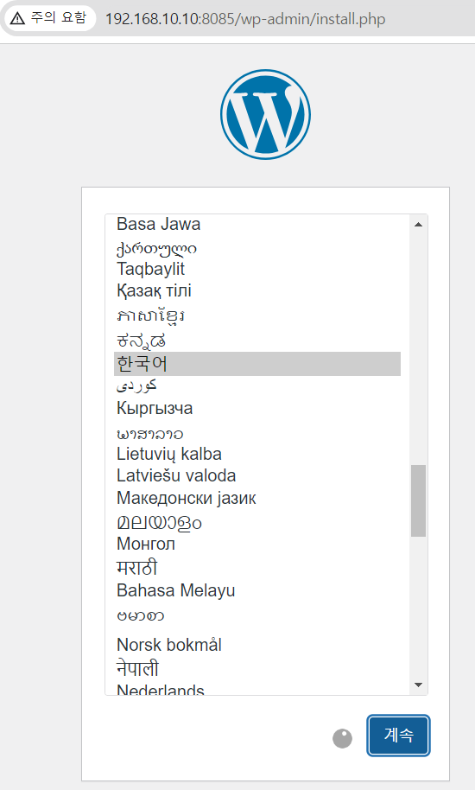
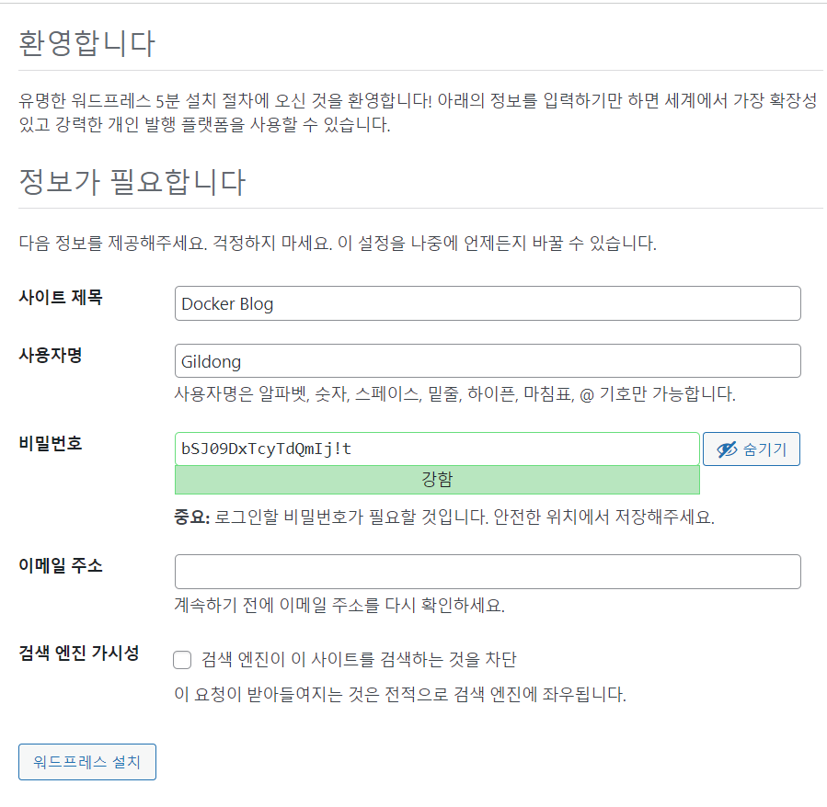

Slide 16
